Slide 1
Mechanics of Material-II
Project presentation

Slide 2
Project Title
Design a rear dead axle for carrying maximum 1500kg load. Find Principal stresses for the designed structure under assumed loading. Optimize your solution by properly selecting material and geometry to reduce mass and cross section size

Slide 3
Group Members
Sr. No | Names | Reg No
1 | Junaid Yaseen | 241247
2 | Muhammad Usman Khan | 241202
3 | Areeba | 241253

Slide 4
Introduction
Rear axle is an important structural component.
Supports vehicle body and payload
Maintains wheel alignment
Transfer load to suspension system.
Pickup trucks experience heavy loading condition.

Slide 5
Importance of Rear Axle
Supports vertical loads
Maintains stability
Resists bending and shear
Provides wheel mounting
Improves ride comfort

Slide 6
Aim of the Project
To design a safe and optimized rear dead axle for Hyundai H-100 pickup truck capable of carrying 1500 kg maximum payload.
Main goals:
Safety
Strength
Reduced weight
Cost effectiveness

Slide 7
Project Objectives
Design rear dead axle
Calculate support reactions
Determine bending and shear stresses
Calculate principal stresses
Select suitable material
Optimize axle geometry
Evaluate factor of safety

Slide 8
Literature Review
Hollow axles provide better strength-to-weight ratio.
Alloy steels widely used in automotive applications.
Analytical methods still important despite FEA tools.
Stress analysis essential for axle reliability.
Previous studies support hollow axle advantages.

Slide 9
Dead Axle Overview
What is a Dead Axle?
Non-driven axle
Does not receive power from engine
Primarily supports vehicle weight
Commonly used in trucks and trailers
Main Purpose
Improve load carrying capacity
Increase vehicle stability

Slide 10
Live Axle Vs Dead Axle
Live Axle
Dead Axle
It transmit powers.
Its main function to drive wheels
It has complex geometry
It has higher Maintenance
It can not transmit power
Its function is to support load
It has simple geometry.
It has lower maintenance

Slide 11
Hyundai H-100 Overview
Light commercial vehicle
Widely used for cargo transportation
Known for durability
Moderate payload capacity
Suitable for commercial applications

Slide 12
Design Methodology
Determine loading conditions based on vehicle specifications
Calculate support reactions at wheel mounting locations
Perform shear force analysis along the axle length
Perform bending moment analysis to find critical sections
Select suitable material based on mechanical properties
Design axle geometry (solid vs hollow cross-section)
Calculate bending stress, shear stress, and principal stresses
Optimize geometry and material for minimum weight
Verify factor of safety for reliable operation

Slide 13
Design Assumption
The axle is modelled as a simply supported beam at wheel mounting locations
Load is applied as point load 0.3 m away from the wheels
Static loading conditions are considered for preliminary design
Shock and impact factor of 1.5 is included in calculations
The axle behaves as a linear elastic material (Hooke's Law valid)
Symmetrical loading is assumed for simplified analysis
Stress concentration effects are neglected
Temperature effects are not considered in this analysis

Slide 14
Load Calculations
The formula is W = mg
Where w is weight
M is mass
G is gravitational acceleration.
Main Loads Acting on Axle (65% on dead axle)
W_{d} = 0.65 x 1500 x 9.81 = 9564.75 N
Load on Point C and Point D are equally distributed that is W_{d} /2 = 4782.375 N each

Slide 15
Support Reactions
For symmetrical loading conditions:
R_{A}= R_{B} = W_{d} /2
Where:
R_{A} and R_{B}= Reactions at supports
W_{d} = Dynamic load acting on axle

Slide 16
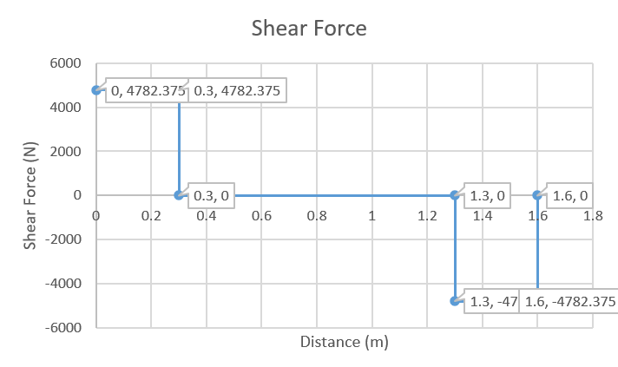
Shear Force Analysis
The maximum shear force occurs near the supports and is equal to the reaction force.
Where:
V_{max}= Maximum shear force
Wd = Dynamic load
The bending moment and shear force are the primary parameters used for axle stress analysis.

Slide 17
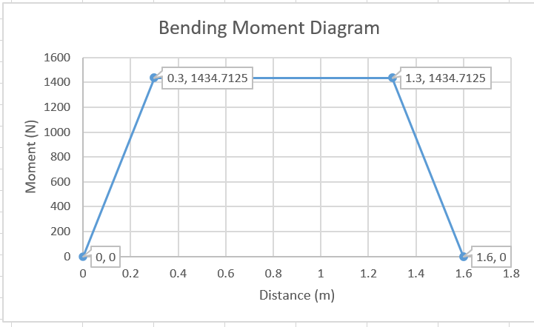
Bending Moment Analysis
Maximum bending occurs at centre of axle.
Bending moment is critical for axle design.
Used to determine bending stress.
Importance
Prevents structural failure
Ensures safe operation

Slide 18
Optimization and Factor of Safety
Optimization Goals
Reduce mass
Reduce material usage
Maintain safety
Factor of Safety
Selected FOS = 2.5
Ensures reliable operation

Slide 19
Allowable Stresses
FOS = Yield Strength / allowable Stress
FOS = 2.5
Allowable Normal Stress = 166 MPa
Allowable Shearing Stress = 96 MPa

Slide 20
Bending Stress Equation
The bending stress in the axle is determined using:
σ = Mc / I
Where:
σ = Bending stress
M = Bending moment
c = Distance from neutral axis to outer surface
I = Moment of inertia
I = π (D⁴) / 64
c = d/2
Using this Bending Stress formula, we calculated the Diameter for our rear dead axle.
Shaft is taken solid
Diameter of Solid Shaft = 45 mm

Slide 21
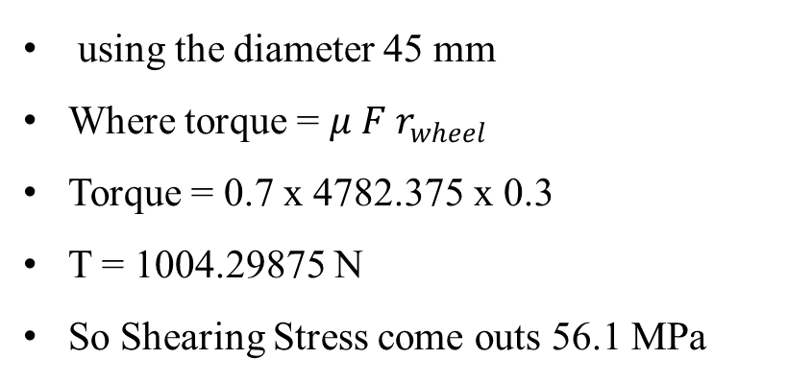
Shear stress
The axle also experiences torsional shear stress due to braking force.
The approximate shear stress equation is:
τ = Tc / J
Where:
τ = Shear stress
T = Torque
c = Distance from neutral axis to outer surface
I = Moment of inertia
using the diameter 45 mm
Where torque = $μ F r_{wheel}$
Torque = 0.7 x 4782.375 x 0.3
T = 1004.29875 N
So Shearing Stress come outs 56.1 MPa

Slide 22
Principle stresses
Principal Stress Analysis
Axle experiences combined stresses.
Principal stress predicts maximum stress condition.
Helps prevent material failure.
Importance
Safe design
Material selection
Reliability evaluation

Slide 23
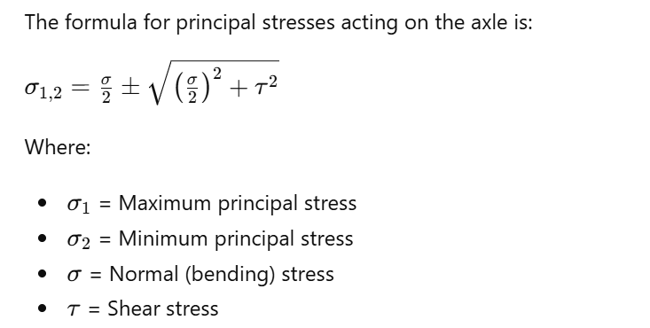
Principle stress formula

Slide 24
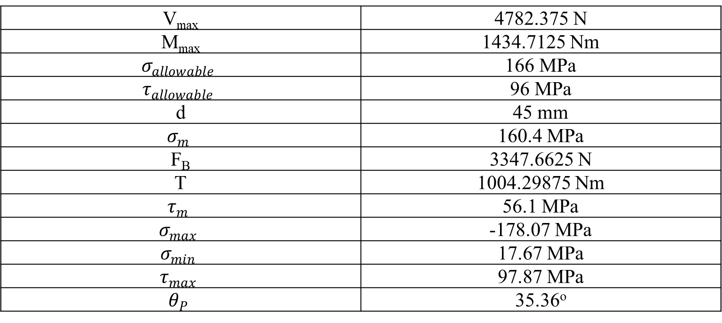
Results
V_{max} | 4782.375 N
M_{max} | 1434.7125 Nm
$$σ_{allowable}$$ | 166 MPa
$$τ_{allowable}$$ | 96 MPa
d | 45 mm
$$σ_{m}$$ | 160.4 MPa
F_{B} | 3347.6625 N
T | 1004.29875 Nm
$$τ_{m}$$ | 56.1 MPa
$$σ_{max}$$ | -178.07 MPa
$$σ_{min}$$ | 17.67 MPa
$$τ_{max}$$ | 97.87 MPa
$$θ_{P}$$ | 35.36º

Slide 25
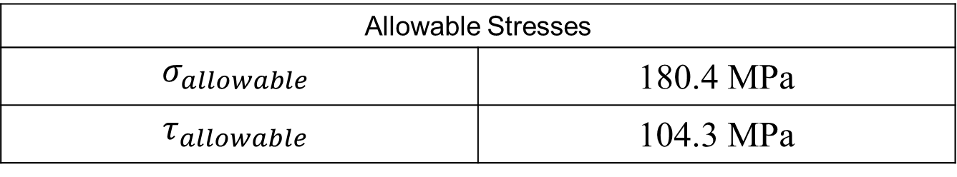
Error Correction
The FOS we selected was failed for principal stresses and then we assume the FOS = 2.3 which makes the beam safe when d = 45 mm.
Allowable Stresses
$$σ_{allowable}$$ | 180.4 MPa
$$τ_{allowable}$$ | 104.3 MPa

Slide 26
Manufacturing Considerations
Manufacturing Methods
Forging
Machining
Heat Treatment
Grinding
Importance
Ensures dimensional accuracy
Improves mechanical properties
Enhances durability and service life

Slide 27

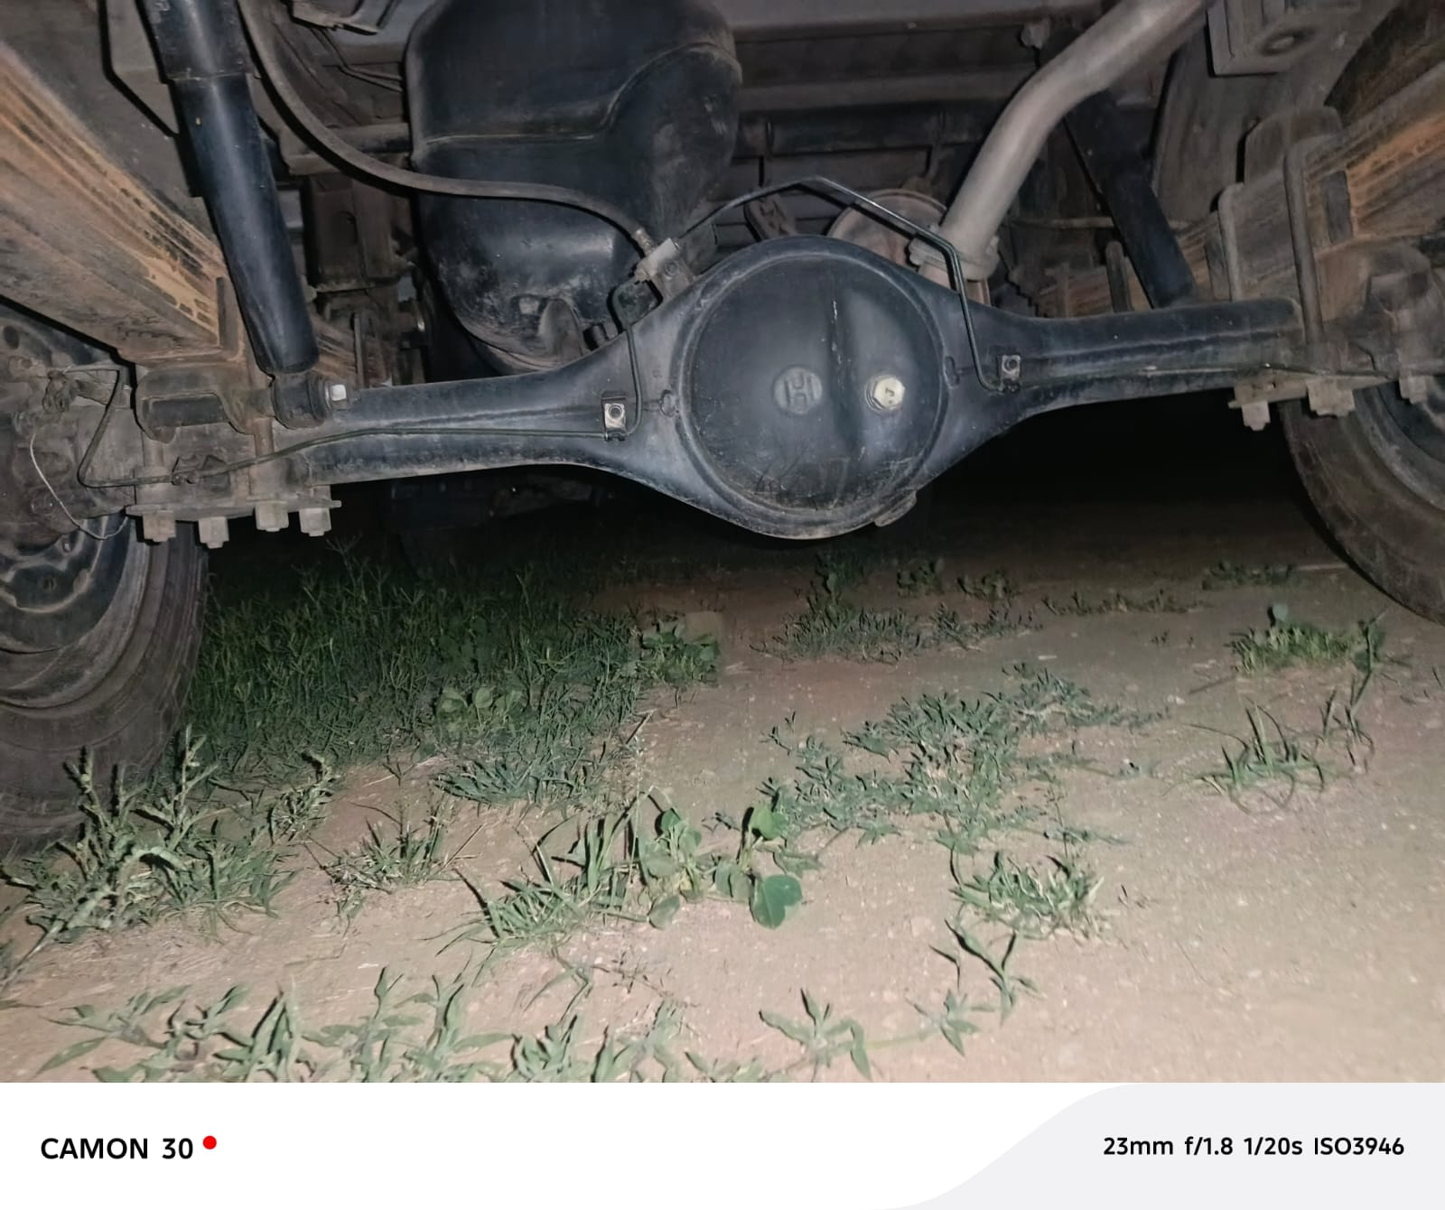
Point Load on Two Points Real life Example

Slide 28
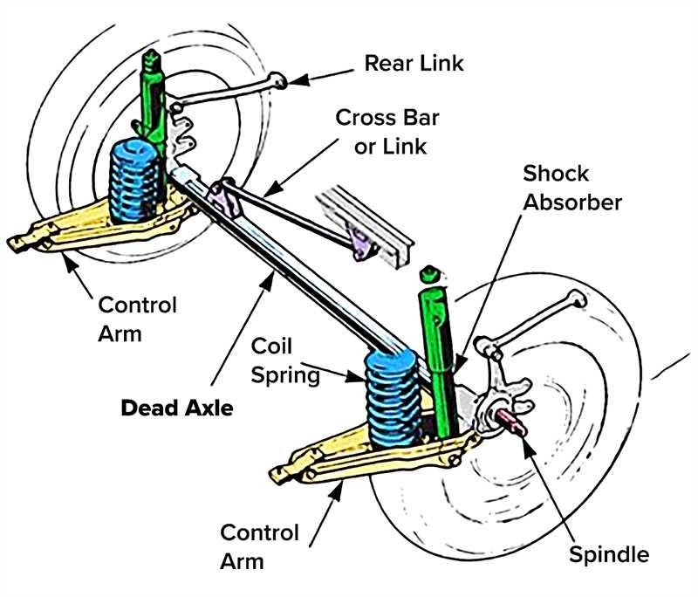

Slide 29
Limitations
Dynamic loading effects simplified
Detailed fatigue analysis not performed
Stress concentration effects neglected
Temperature effects not considered
Finite Element Analysis (FEA) not included

Slide 30
Sources of Error
Shock factor approximation
Material property variations
Dimensional inaccuracies
Human calculation errors

Slide 31
Conclusion
Rear dead axle successfully designed.
AISI 4140 improved structural performance.
Stresses remained within new allowable limits.
Design achieved safe and reliable operation.

Slide 32
Future Recommendations
Finite Element Analysis (ANSYS)
Fatigue life estimation
Experimental testing
Composite material design
Dynamic vibration analysis

